Slide 1
Safety around the Classroom (review from last class!)
1. Look around and locate safety features in the classroom. Discuss each with a classmate.
What is it?
How does it work?
When should you use it?
Who should use it?
Anything you can’t see in the classroom?

Slide 2


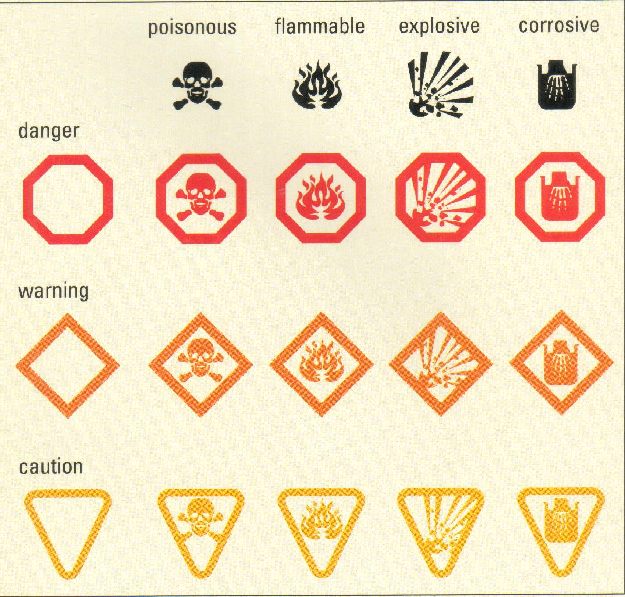
HHPS
HHPS = Hazardous Household Products Symbols
These are consumer products (sold in regular stores)
Examples
Which rooms in your house have you seen these symbols?
(make a list with the person you’re sitting beside)
Notes:
Pest control products
Cleaning products
Cosmetics
Etc.

Slide 3




HHPS
Hazardous Household Products Symbols
CORROSIVE
Eats or wears away other materials.
EXPLOSIVE
Explodes or gives off deadly vapours.
FLAMMABLE
Ignites if exposed to heat or sparks.
POISONOUS
May cause sickness or death if swallowed.

Slide 4

HHPS
Hazardous Household Products Symbols

Slide 5



WHMIS
How do hazardous materials get into the body?
Inhalation
Fumes or particles are breathed in
Absorption
Chemicals can be absorbed by the skin and enter the body
Ingestion
Chemicals enter the body through the stomach

Slide 6



WHMIS
How can we protect ourselves?
hand washing
Personal Protective Equipment (PPE)
Equipment such as masks, goggles and gloves can be used to help decrease the danger of using certain products

Slide 7


WHMIS
WHMIS = Workplace Hazardous Materials Information System
These are products used in industry or labs
Ex. many of the chemicals we’ll use in this class
WHMIS is a system designed to provide information about hazardous materials
The system groups chemicals with similar properties or hazards
Each group has a symbol to help people identify the hazard quickly

Slide 8

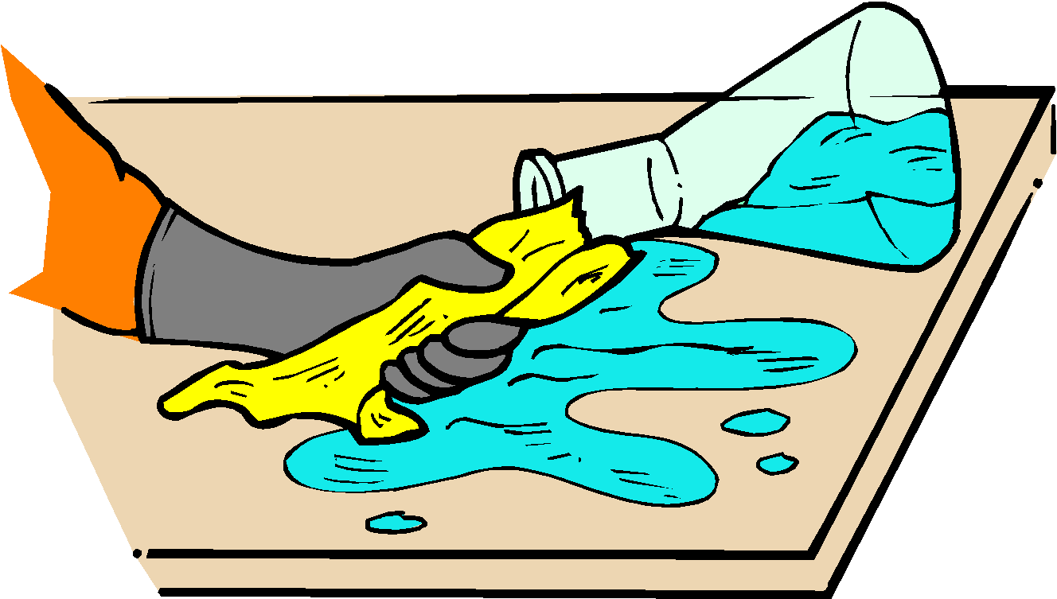
Curiosity about the world
Why is it important to understand WHMIS information, including Material Safety Data Sheets, before using any chemicals?
know what conditions it will react in
know what type of protection is required
know how to deal with spills
how to deal with splash in the eyes
how to deal with contact on the skin
Notes:
C1.1 – Chemistry

Slide 9

WHMIS
Workplace Hazardous Materials Information System
Gives workers, employers and students key safety and handling information on potentially dangerous chemicals used on the job
WHMIS has 3 parts
Warning label
Safety Data Sheets (SDS)
Worker (Student!) training

Slide 10
Now called GHS
In 2015, WHMIS was changed to
GHS
Global Harmonized System

Slide 11


GHS
Warning Labels
Compressed gas
Gasses under pressure
May explode if heated
Flammable
Potential fire hazard
Keep away from heat or potential ignition

Slide 12


GHS
Warning Labels
will produce oxygen gas which would help flammable or combustible material burn
Keep away from combustible materials
Oxidizing material
Poisons (can cause death quickly)
Harmful if ingested or gets on body
Acute Toxicity

Slide 13


GHS
Warning Labels
Can cause chronic health problems but not immediately upon contact
Repeated exposure can cause death or permanent damage
Can cause cancer or birth defects
Health Hazard
Harmful
May cause less serious health effects like skin or eye irritation

Slide 14


GHS
Warning Labels
Poisonous to aquatic life
Can cause long-term damage to aquatic life
Environmental Hazard
Biohazardous & infectious material
May contain biological toxins
mold, viruses, pathogenic bacteria, etc

Slide 15


WHMIS
Warning Labels
Corrosive material
Caustic or acid materials
Causes burns, blindness, lung damage
React with metals
Explosive or Dangerously Reactive material
Material is unstable and can react very easily
May react violently with water

Slide 16









WHMIS 2015 PICTOGRAMS
Health Hazard | Flame | Exclamation Mark
Carcinogen, mutagenicity reproductive toxicity, respiratory sensitizer Specific target organ toxicity-single exposure Specific target organ toxicity-repeated exposure Aspiration hazard | Flammable gases, aerosols, liquids, solids Pyrophoric liquid, solid, gas Self-heating substances Emits flammable gas in contact with water Self-reactive Organic peroxide | Harmful Irritant (skin and eye) Skin sensitizer Acute toxicity (harmful via oral, skin, inhalation) Respiratory tract irritant
Gas Cylinder | Corrosion | Exploding Bomb
Gas under pressure | Skin corrosion Serious eye damage Corrosive to metals | Explosives Self-reactive substances and mixtures Organic peroxides
Flame Over Circle | Skull and Crossbones | Biohazardous Infectious Material
Oxidizers (liquids, solids, gases) | Acute toxicity (fatal or toxic via oral, skin, inhalation) | Biohazardous infectious material

Slide 17
WHMIS
Warning Labels
Supplier labels??
Workplace labels??

Slide 18

SDS (formerly MSDS)
2. SDS = Safety Data Sheet
MSDS = Material Safety Data Sheet
Gives you more specific details about a chemical
How to deal with spills
How to treat yourself if you come in contact with the chemical

Slide 19

WHMIS Training
3. Worker (Student!) Training
WHMIS training is required in most workplaces and for all science students

Slide 20


Curiosity about the world
What sources of information are available on the safety or environmental implications of chemicals and chemical reactions?
SDS
WHMIS labels
Why is it important to ensure that these sources are up to date?
To ensure that you have the most current way of dealing with potential problems that may arise
http://marineinsight.com/wp-content/uploads/2011/04/msds.jpg
http://nobel.scas.bcit.ca/debeck_pt/science/images/labsafety.jpg
Notes:
C1.1 – Chemistry

Slide 21
Read an SDS
Go over your SDS:
identify hazard symbols, look at hazard categories (eg acute toxicity, Category 1)
Route of entry if given (eg fatal if contact with skin)
First Aid
spill clean up
PPE
Toxicological - Look for LD50 (and route/animal) or LC50

Slide 22
How to interpret LD50 & LC50
A substance is considered highly toxic if it has LD50 of 5-50 mgs/kg of animal body weight or an LC50 of <200 ppm or <2,000 mg/m3 .

